Slide 1
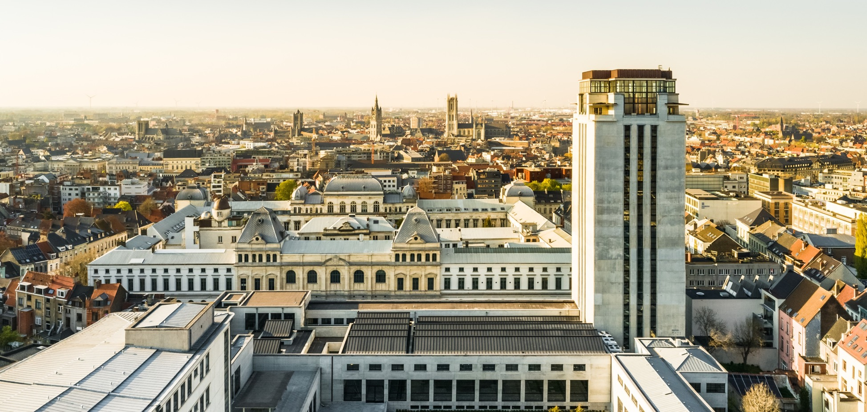

THIS IS
GHENT UNIVERSITY
Top 100
university
Since
1817
DARE TO
THINK

Slide 2












Ghent
University
→ Top 100 university
→ Since 1817
→ 11 faculties
Belgium
South korea
The 1st European university in South Korea.
Dare to think
Our credo: critical and independent minds.
PLURALISM &
PARTICIPATIon
Open to everyone irrespective of ideological, political, cultural or social background.
sustainability
For a future that is ecologically, socially and economically sustainable, within a local global context.
+200 programmes
69
English-taught master’s programmes
2,320
Ghent University
students abroad
7,600
International students
at Ghent University
50,900
students
15,700
employees
Notes:
Ghent University is a top 100 university, founded in 1817, and one of the major universities in Belgium with 50,000 students and 15,500 employees. Our 11 faculties offer more than 200 courses and conduct in-depth research within a wide range of scientific domains. Our credo is ‘Dare to Think’, challenging everyone to question conventional views and to dare to take a nuanced stand. We are a pluralistic university open to all, regardless of their ideological, political, cultural or social background. Ghent University Global Campus is also the first European university in Songdo, South Korea.
www.ugent.be
#ugent

Slide 3
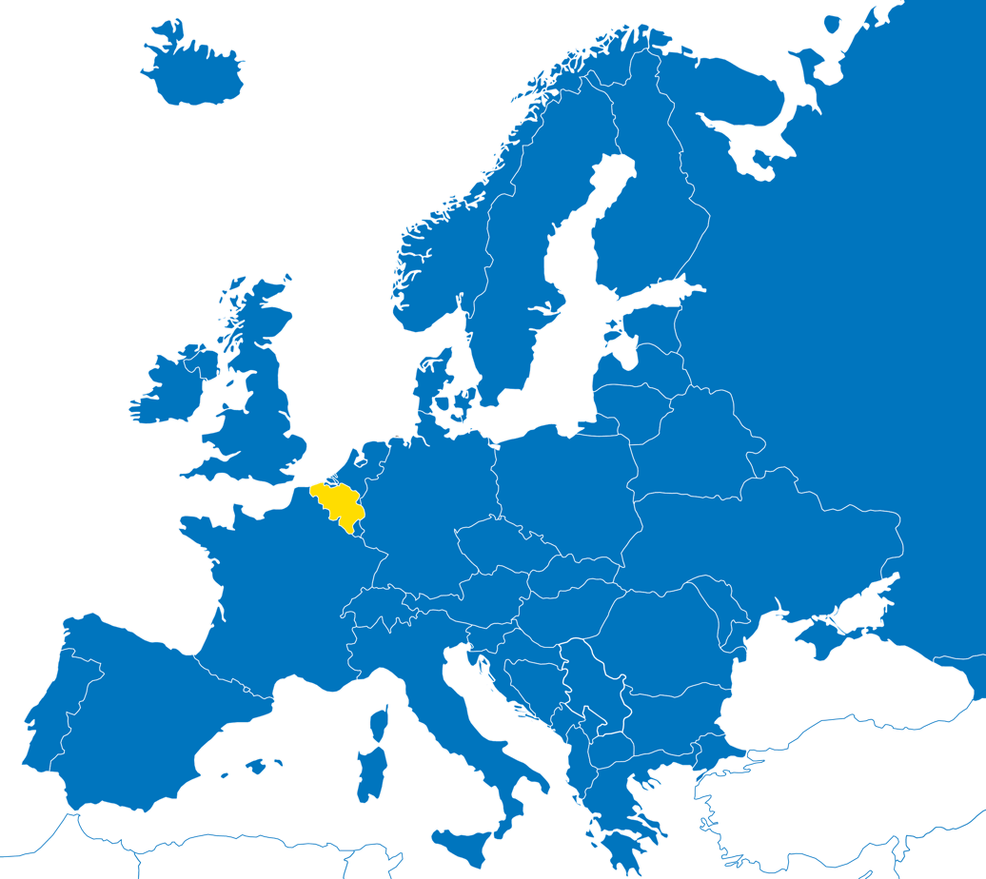
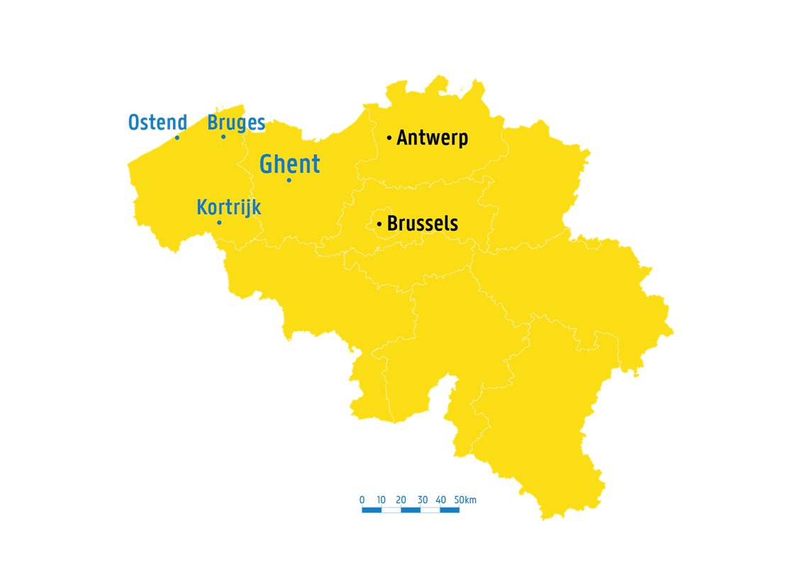
IN BELGIUM
In the heart of Europe
London
350 km
Amsterdam
350 km
Berlin
800 km
Paris
300 km
Notes:
Ghent is located in Flanders, Belgium. The city is close to a few major European cities like Brussels, Paris and Amsterdam.

Slide 4

education

Slide 5

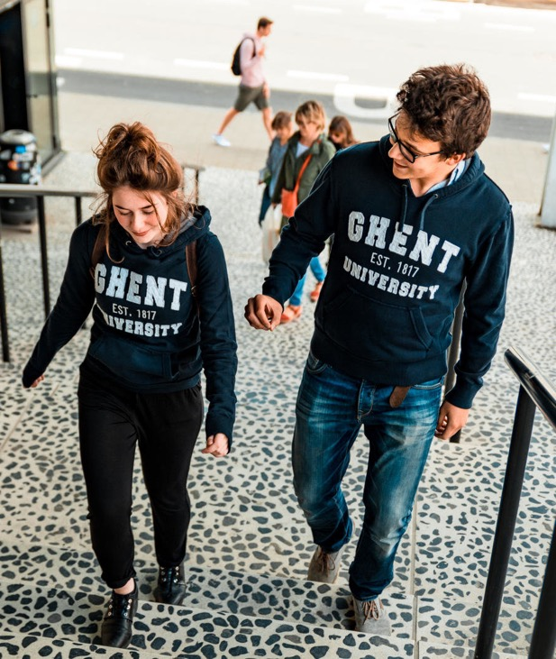
Six strategic education objectives
Notes:
We put our multiperspectivistic vision on education into practice by means of six strategic education objectives. These objectives make up the framework for high-quality education at our university.
More info: https://www.ugent.be/en/ghentuniv/mission/educational-strategy/education-vision

Slide 6
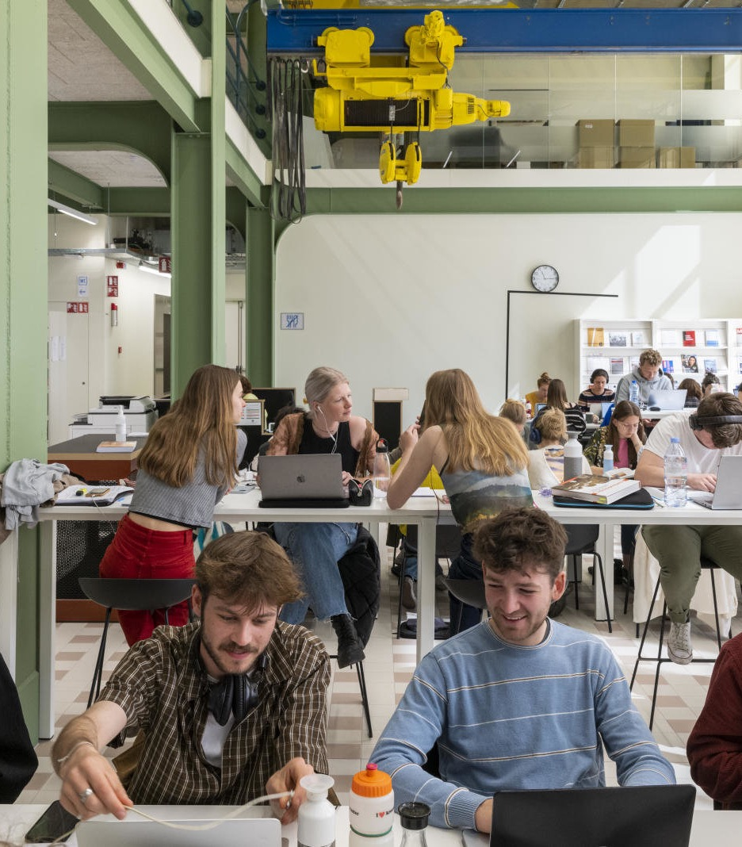
programmes
Bachelor | 51
Master | 140
Other programmes | 58
(reference date: October 2025)

Slide 7











STUDENTs
Total number of students 50,936 |  |  | 49,921
Faculty of Medicine and Health Sciences | 10,389 | Faculty of Sciences | 3,674
Faculty of Economy and Business Administration | 6,401 | Faculty of Political and Social Sciences | 3,375
Faculty of Psychology and Educational Sciences | 6,156 | Faculty of Bioscience Engineering | 2,816
Faculty of Engineering and Architecture | 5,759 | Faculty of Veterinary Medicine | 1,859
Faculty of Arts and Philosophy | 4,636 | Faculty of Pharmaceutical Sciences | 1,490
Faculty of Law and Criminology | 4,476 | Ghent University Global Campus | 543
Data reference date: 15 october 2025
Students participating in all of our study programmes, from every possible type of study programme, are included above.
The total number of students per faculty is higher than the total number of students enrolled at Ghent University since there are students who are enrolled in multiple faculties.

Slide 8
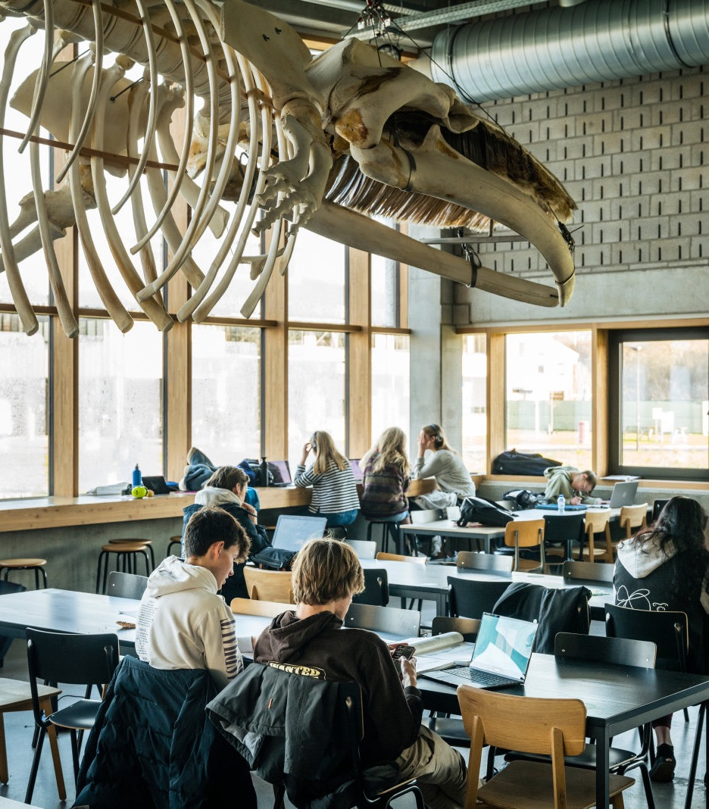
STUDENTs
Total | 50,936
Bachelor | 25,271
Master | 16,160
Other programmes | 4,177
Doctorate | 4,861
(reference date: 15 october 2025)
The total amount of students per study programme type is higher than the total amount of students enrolled
at Ghent University since there are students enrolled in multiple study programmes and study programme types.
Reference date: the number of students and the number of doctoral students in particular increases during the academic year.

Slide 9
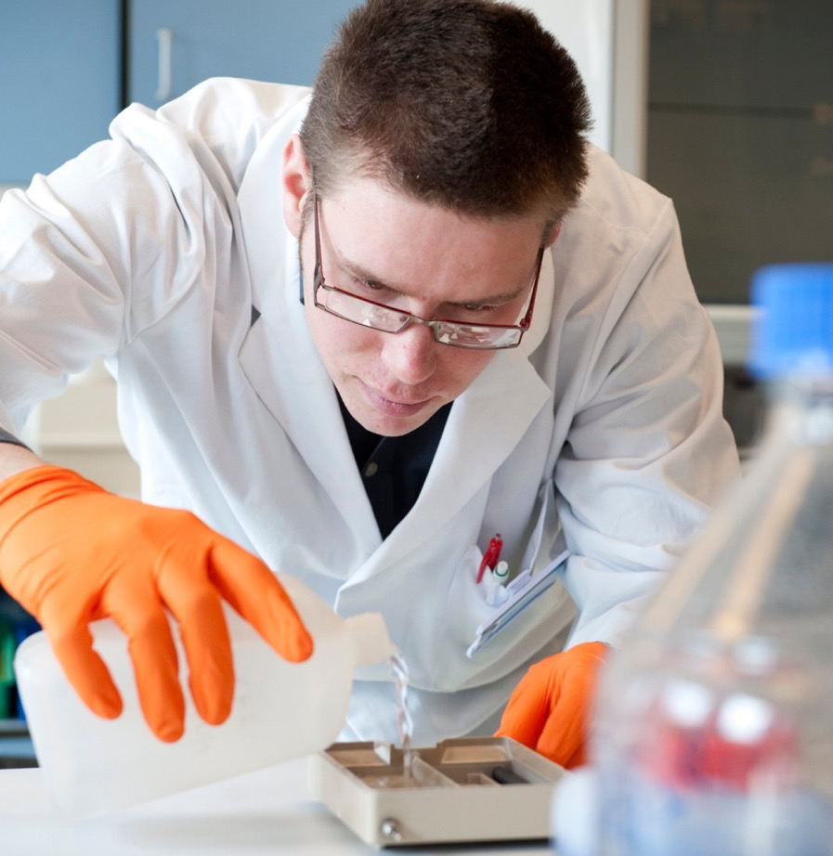
research

Slide 10


researchers
FTE researchers | 8,267
Professors | 1,164
Postdocs | 1,607
Predocs | 5,496
Tailor-made
Career prospects
TALENT development
& training
(reference date: October 2025)
Quality
recruting
scientific
integrity
Leadership
& trust

Slide 11
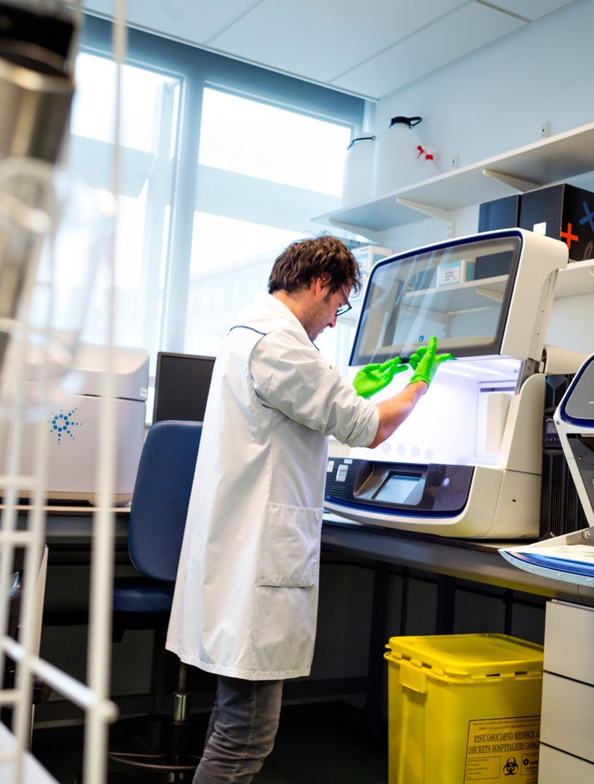
DOCTORAL SCHOOLS
Three-fold mission of the Doctoral Schools
To increase the international and social value
of the doctorate
To enhance the support provided to
doctoral students
To strengthen a quality culture in
(doctoral) research
797
Doctorates obtained
in 2024
+5,800
Doctoral students in total
International: 47%
(reference date: October 2025)

Slide 12

INPUT
172 main ERC projects
27 PoC grants
Research expenditure 2024: € 533 million

Slide 13
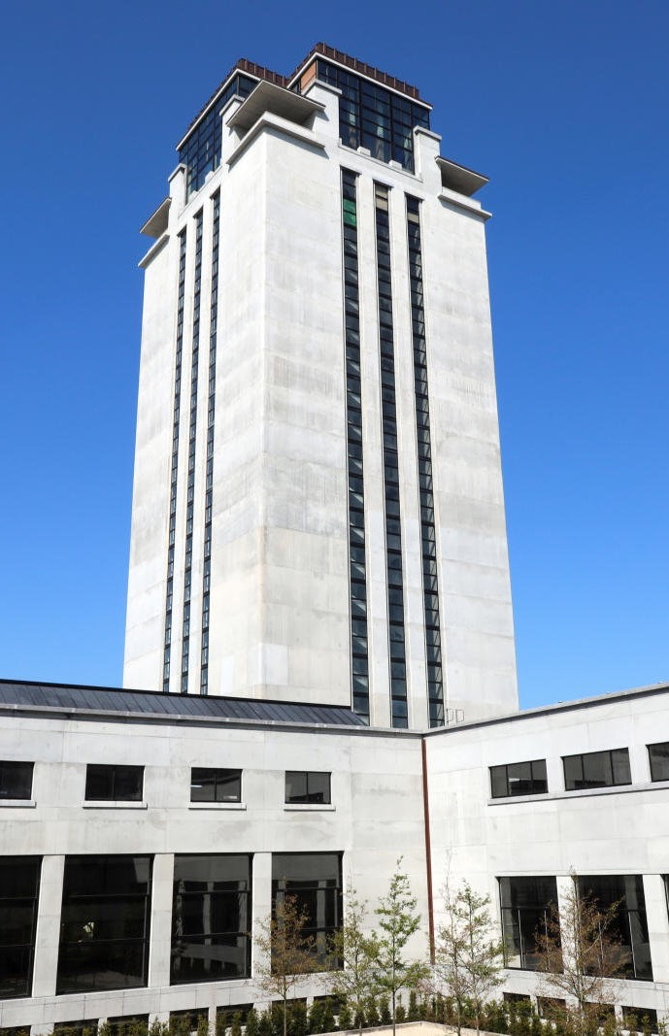
OUTPUT
Publications 2014 - 2024
Total number of publications at Ghent University | 93,241
International publications | 55,820
Solely Ghent University | 20,938
Belgian publications | 16,483
Highly cited researchers (clarivate, 2022) | 25
(Publications: WOS (SCIE, SSCI, AHCI, CPCI-S, CPCI-SHW) and VABB – reference year 2025)
Notes:
Highly cited researchers:
https://www.ugent.be/nl/actueel/highly-cited-2019-geciteerd-publicatie.htm

Slide 14
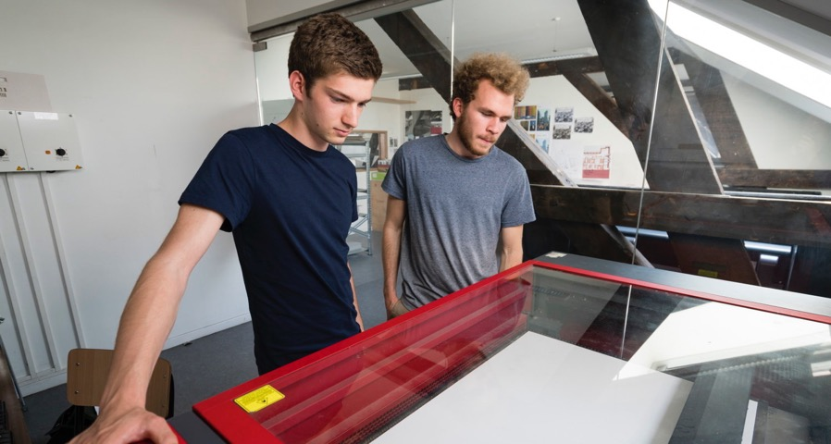
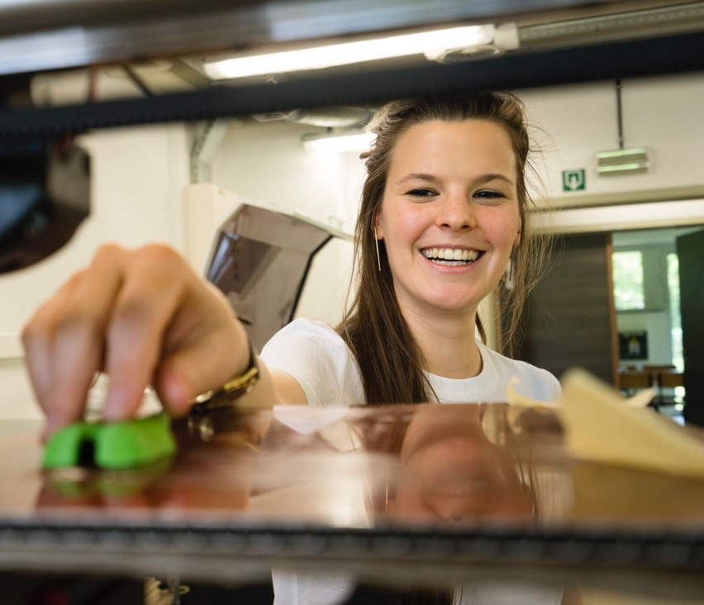
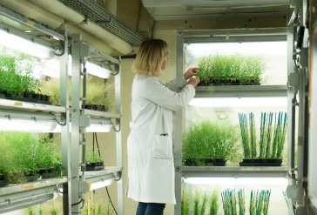

TECHTRANSFER
27
BD Centers
88
spin-offs
(2014-2024)
1,609
patents
(2014-2024)
Intensive cooperation
with companies

Slide 15

ERC GRANTS
150 GRANTEES
Notes:
More info: www.ugent.be/en/research/funding/eu-int/erc-ugent.htm

Slide 16
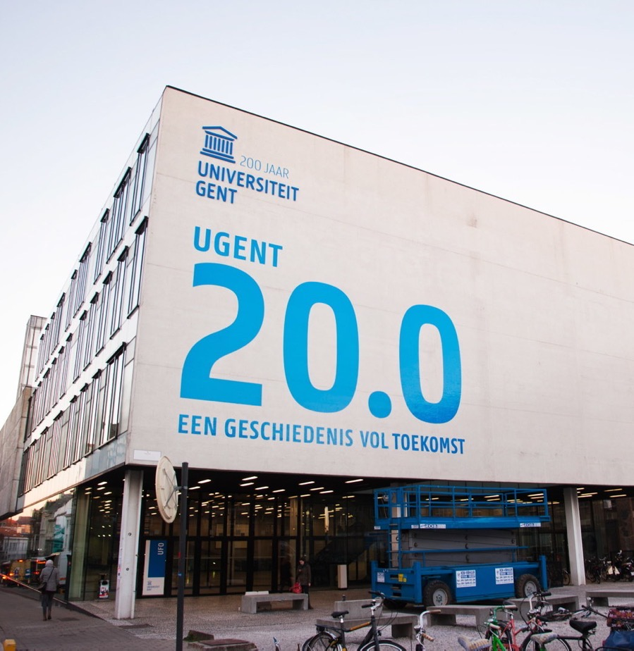
200 years
of history

Slide 17



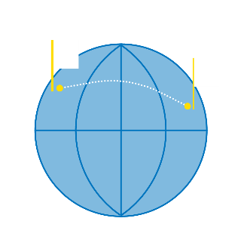

200 years ghent university
1817
Grand opening of
‘Rijksuniversiteit Gent’
Latin is main language
1876-1890
Focus on education and research
1991
RUG becomes
‘Universiteit Gent’
2013
Integration university college curriculum
2017
200 years
Ghent
University!
1830
French becomes
the official language
1930
Dutch becomes
the official language
2004
Ghent University
Association (AUGent)
2014
1st European
university in South-Korea
Notes:
9 October 1817 – In comparison with other European universities, the Ghent Alma Mater is relatively young. The institution was inaugurated on October 9th, 1817, after King William I had proclaimed the establishment of three universities in the Southern Netherlands in the preceding year.
Lectures started on November 3rd. The first professorial staff had sixteen members, including nine foreigners, mainly Northern Dutch and Germans. In 1817, a total of 190 students registered in the four faculties: Arts, Law, Medicine and Sciences.
1830 – The political separation from the Netherlands in 1830 had disastrous consequences for education in Ghent as two faculties were abolished: Sciences and Arts. Although the Higher Education Act of 1835 returned the two faculties to Ghent University and also added the Technical Schools, the recovery proceeded very slowly.
Thirty-five years would pass before the student population level of 1830 was once again attained. Nevertheless, during this period Ghent University won a great number of prizes in the university competitions.
1876 – 1890 - The introduction of Dutch as the official language in 1930 coincided with a change in the University's language status. The language of instruction from its establishment by William I of Orange till the separation from the Netherlands was Latin, from 1830 till 1930 it was first French and then a bilingual system, and after 1930 it was Dutch.
A systematic and thorough modernization of higher education in Ghent took place after the Acts of 1876 and 1890 were passed, which granted universities the power to award academic degrees and enabled scientific development. Laboratory exercises and laboratory research work got their start in this period and research assistants were also appointed.
Over the years, the professorial staff has included a number of eminent figures: jurists Jean-Jacques Haus and François Laurent, physicist Joseph Plateau, mathematician Paul Mansion, physiologist and psychiatrist Joseph Guislain, historians Henri Pirenne and Paul Fredericq, Germanic scholars Joseph Vercoullie and Henri Logeman, and zoologist and botanist Julius Mac Leod, who was also the spiritual father of the Flemish-speaking Ghent University.
1930 – Dutch became the official language of Ghent University in 1930, the year Belgium celebrated its first centennial. This made it the first institution in the country to offer its educational programmes in Dutch.
1991 – A university stands or falls on the basis of the scientific research it produces. In the past, the university's fame was in the hands of individual scholars who taught and carried on research. In the last decades, because of the explosion in the growth and range of scientific research, this was no longer feasible. Research increasingly became a matter of teamwork and interdisciplinary collaboration.
As a consequence of the reform of the State, the regional communities enjoyed wide powers of decision. For instance, on education. The decree of 1991, which assigned great autonomy to the University, provided new challenges on education and research in an international perspective.
2003 – In 2003 Ghent University joined forces with Hogeschool Gent, Arteveldehogeschool and Hogeschool West-Vlaanderen to form the Ghent University Association.
2014 – Ghent University opens up its first campus in Songdo, South-Korea. Its curriculum offers 3 bachelor’s study programmes: Molecular Biotechnology, Environmental Technology, and Food Technology. They are taught by a permanent staff, supplemented by a ‘flying faculty’ made up of Ghent University lecturers that periodically fly over to teach four-week-long modules.

Slide 18
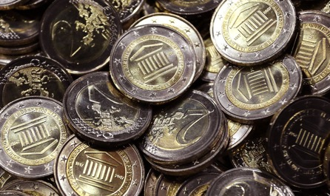
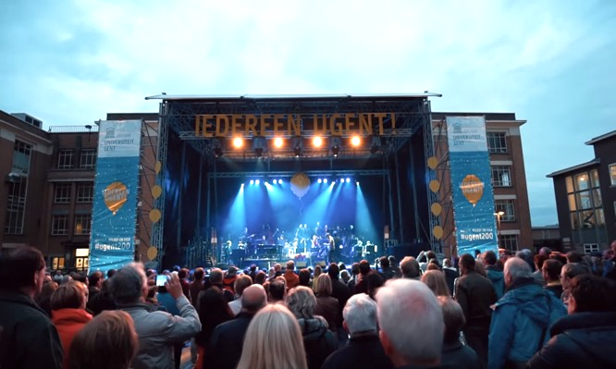

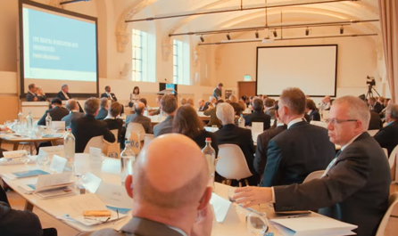

200 years ghent university (2017)
Bike trip 200 km &
International rowing regatta
Logo on 2 euro coin + postage stamp
Festival
‘Everyone Ghent University’:
25,000 visitors
Visit 80 rectors
Notes:
In 2017 Ghent University celebrates its 200th birthday.

Slide 19
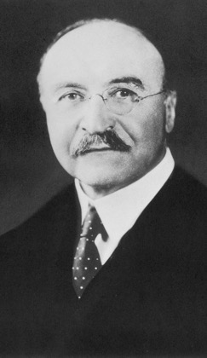
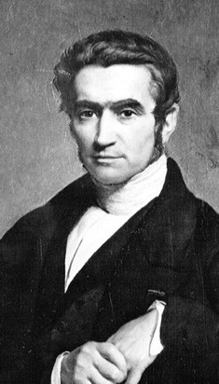
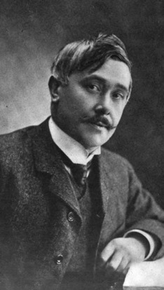

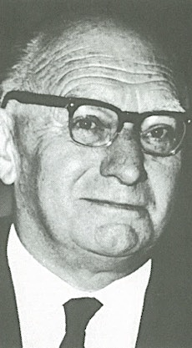
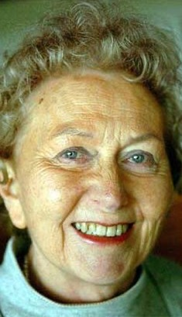
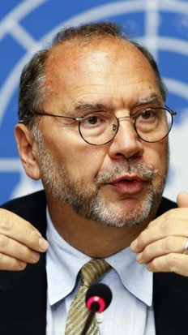

ALUMNI and NOBEL PRIze winners
Marguerite
De Riemaecker-Legot
First female Belgian
Minister of State
Lily Boeykens
Prominent feminist,
chairman of International Council of Women
Adolphe Quetelet
Statistics in
social sciences
Leo Baekeland
Inventor of Bakelite
Maurice Maeterlinck
Playwright, poet,
essayist
Corneel Heymans
Physiologist
and Rector
Peter Piot
Research in
Ebola and AIDS

Slide 20

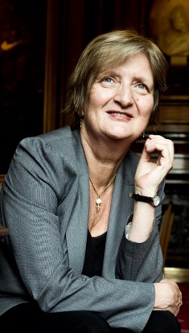
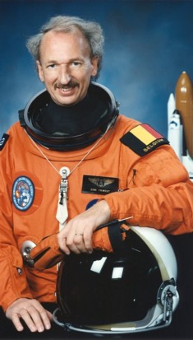
Ghent university ALUMNI
Dirk Frimout
First Belgian in space
And more!
Graduated annually:
7,000 masterstudents
700 PhD-students
Marleen Temmerman
Director of WHO 2012-2015

Slide 21
www.ugent.be/alumni/en

Slide 22
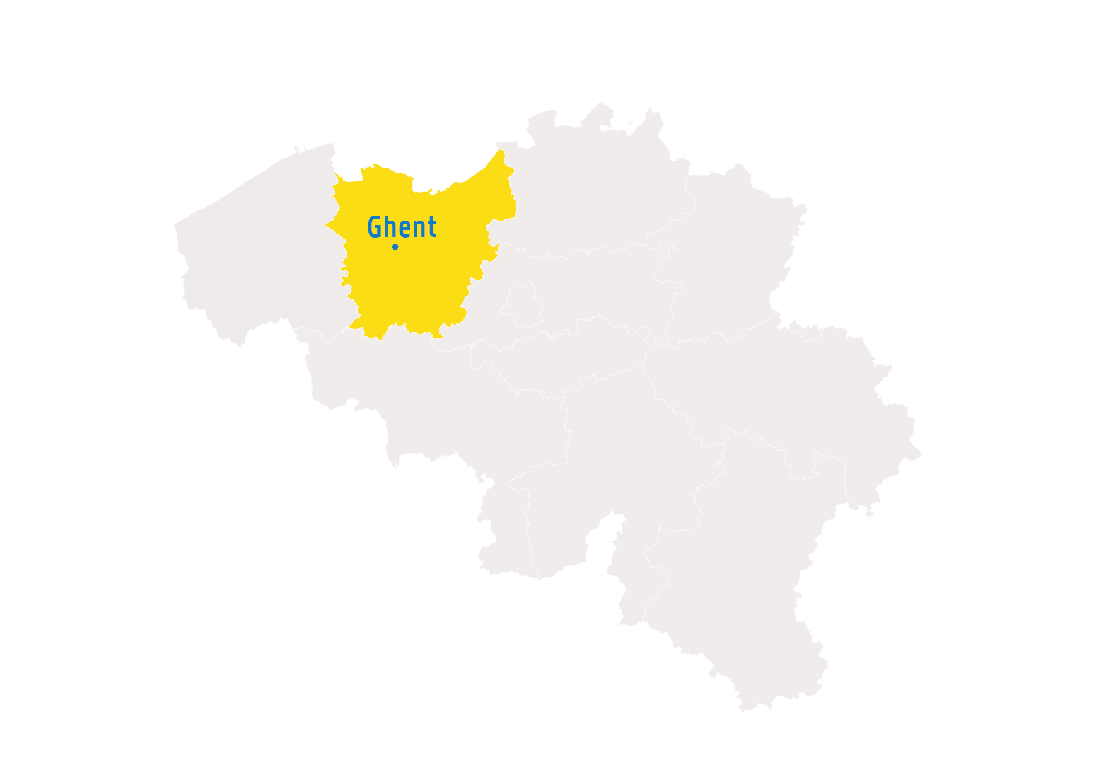
Ghent
university
In ghent

Slide 23
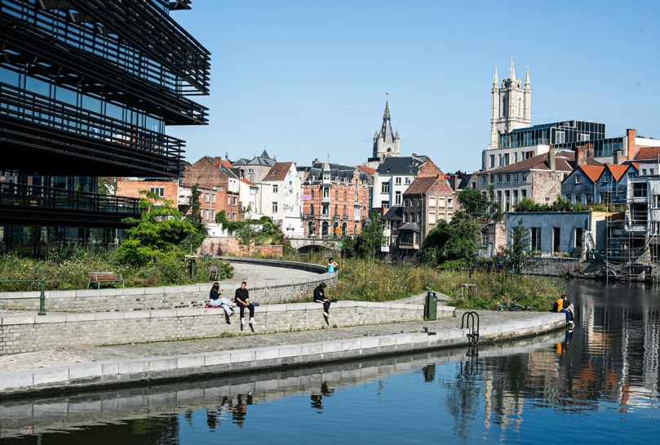

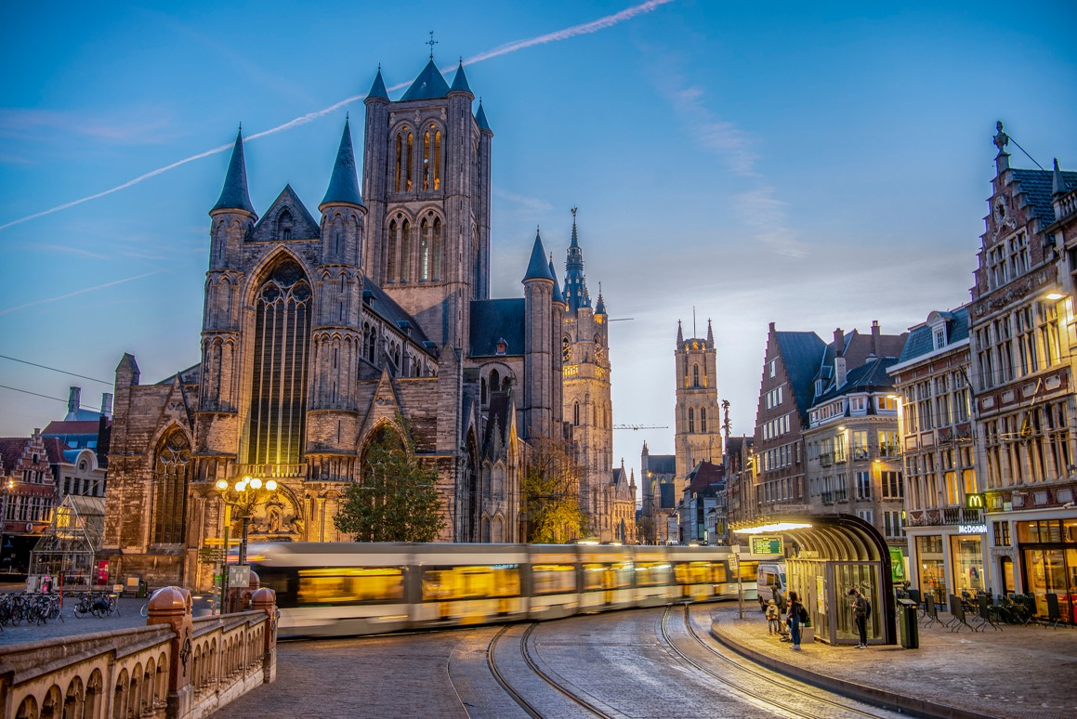
© Stad Gent - Bas Bogaerts
GHENT IN NUMBERS
158 km²
274,000 inhabitants
162 nationalities
37,500 enterprises
87,638 students
© Stad Gent
(source: www.thisis.gent)
© Stad Gent - Dienst Toerisme, Bas Bogaerts

Slide 24
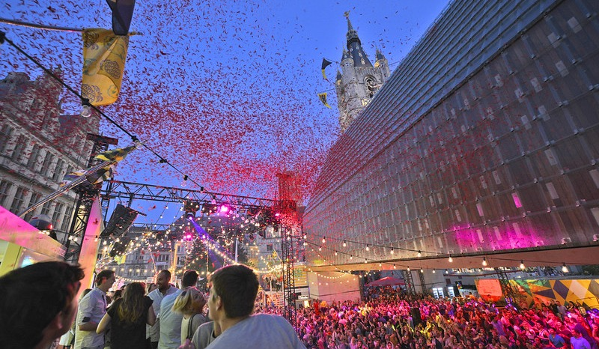
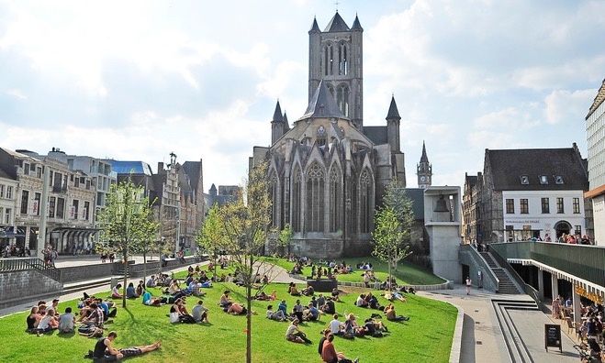
Ghent: offbeat city
in the heart of Europe
A pocket-sized metropolis
Ghent is Belgium's third largest city and Flanders' biggest university city: buzzing with urban bustle, a stunning cultural offer and the traces of a 1000 year rich history.
Behind this ancient look is a place that focuses on the future. Driven by its true nature of rebellion and quirkiness, Ghent experiments with innovative policies.
Knowledge-driven
Together with its people, ventures and knowledge centers, the city finds cutting-edge solutions to tomorrow's challenges. This inspires many other cities and grants Ghent international recognition.
More info: www.visitgent.be
© Stad Gent
© Stad Gent

Slide 25
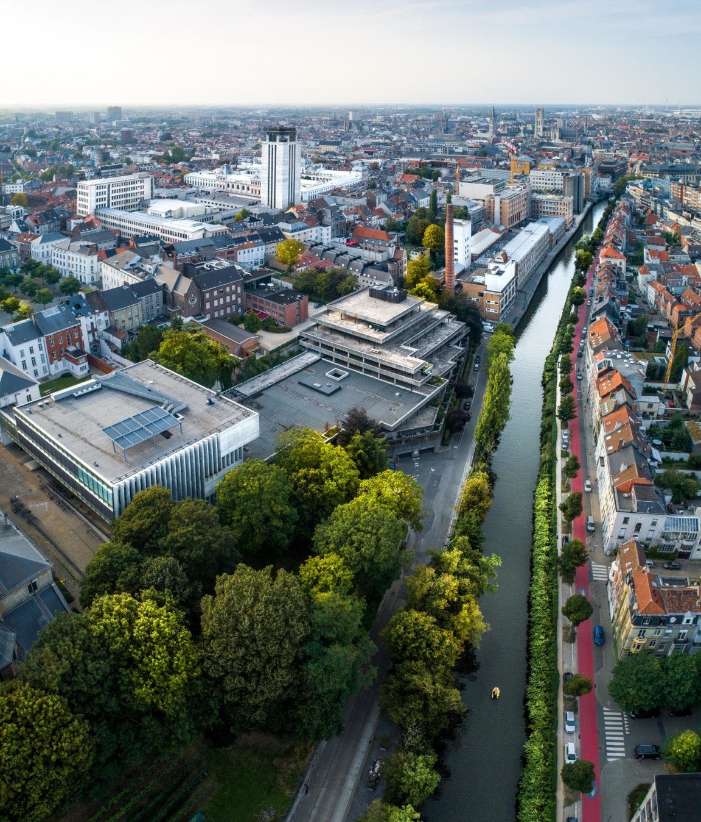
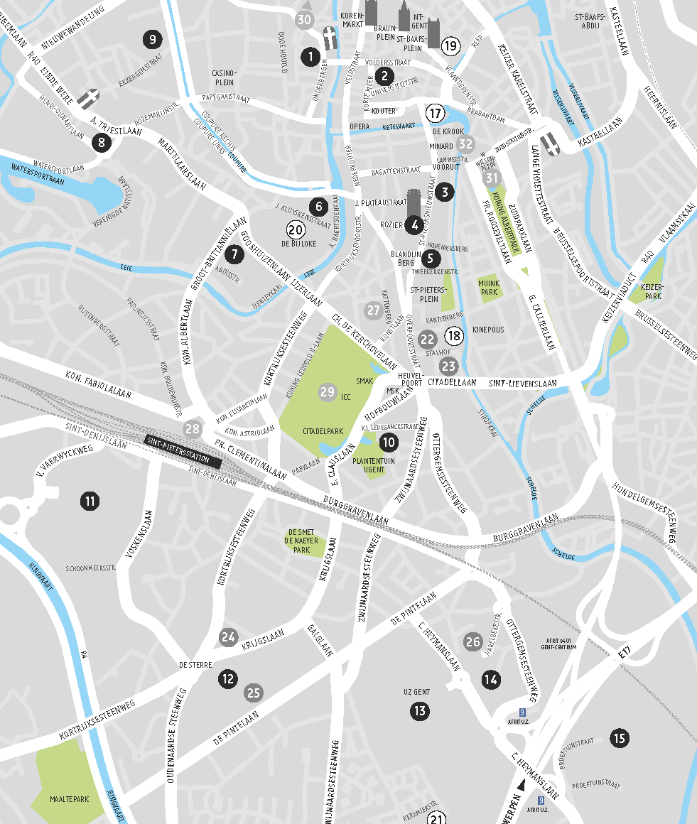
19 CAMPUSes - ghent region
Notes:
Ghent University has different campuses in the city center and around the region of Ghent: Zwijnaarde, Merelbeke, …

Slide 26



famous MONUMENTs - ghent
360° view
Boekentoren
(Book Tower)
64 m tall
3 million books
architect Henry van de Velde
4th tower of Ghent
Aula
Logo of Ghent University
formal ceremonies

Slide 27
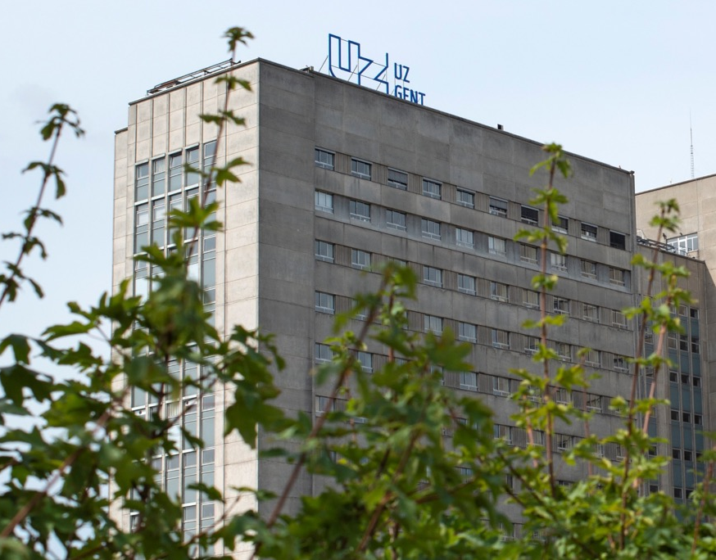
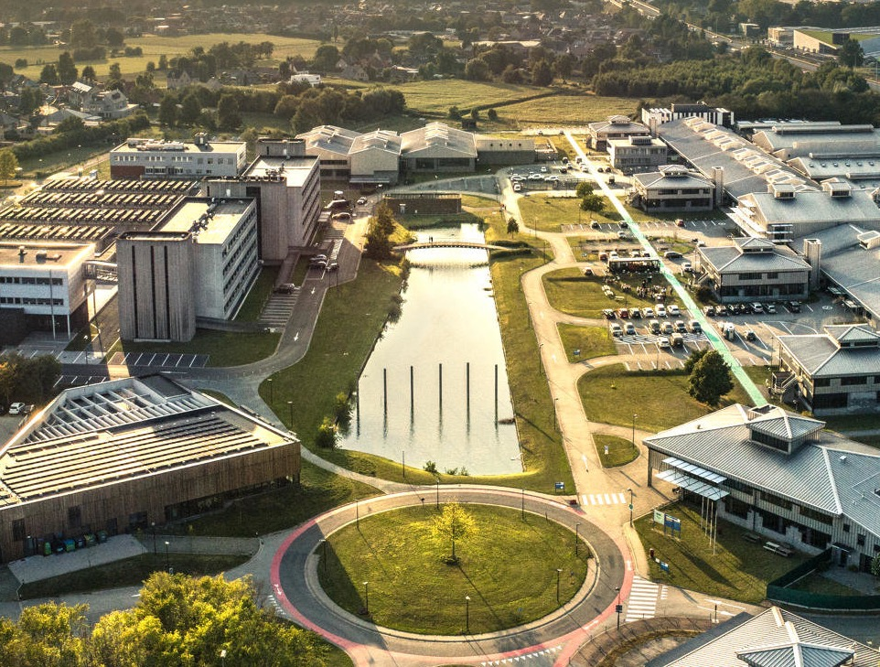
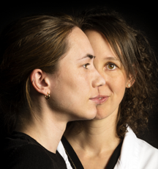
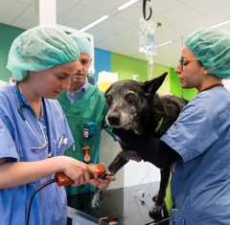
Hospitals - ghent
Ghent University Hospital (UZ Gent)
6,725 employees
103,300 admissions
540,000 consultations
35,000 surgeries
Think Care
Innovation
Expertise
Warm care
Top employer
Veterinary clinic
1,627 students
64 interns and specialists in training
More than 21,000 patients annually
Notes:
Source UZ Gent: https://www.uzgent.be/kerncijfers

Slide 28
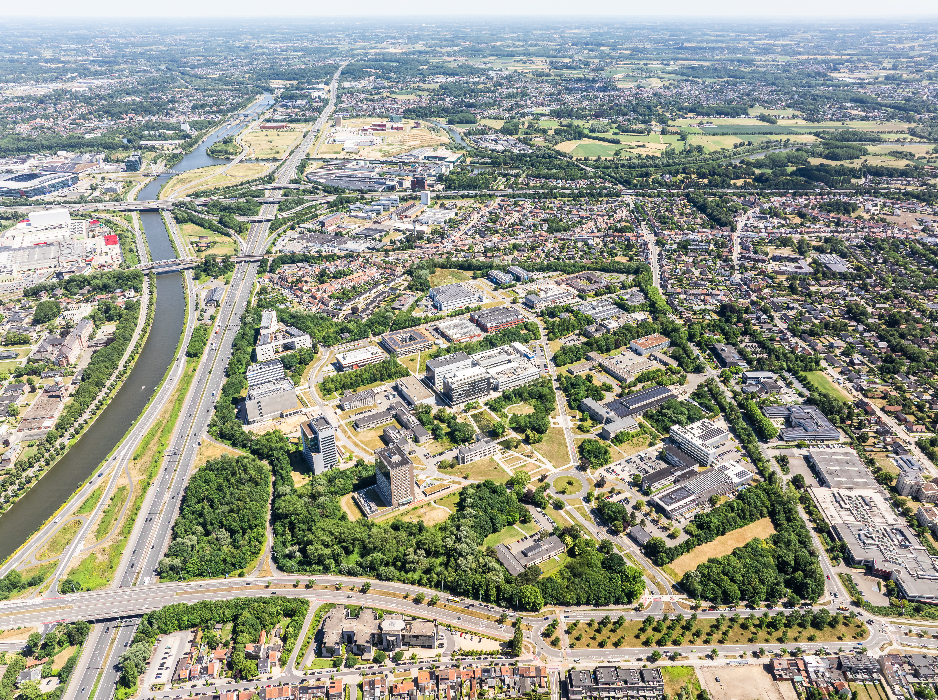
Science park
Tech Lane Ghent
+120 companies: start-ups to multinationals
Campus Ardoyen
Focus: Deep Tech
+5,200 R&D staff members
226,000 m² + 90,000 m² Ghent University
techlane.be
Campus Eiland
eilandzwijnaarde.be

Slide 29

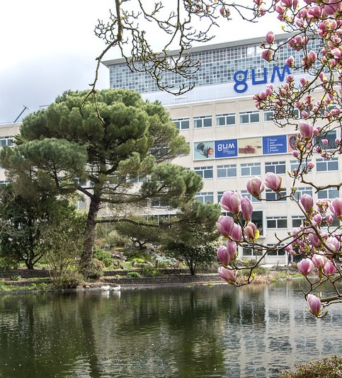

GUM - GHENT UNIVERSITY museum
Science museum
and botanical garden
Notes:
The GUM (Ghent University Museum) opened in 2020 and is located at the heart of the Ghent Botanical Garden, right around the corner from MSK Ghent and S.M.A.K. The GUM is a museum dedicated to science, research and critical thinking, where visitors can discover that science is the result of trial and error, doubt and imagination. www.gum.gent

Slide 30
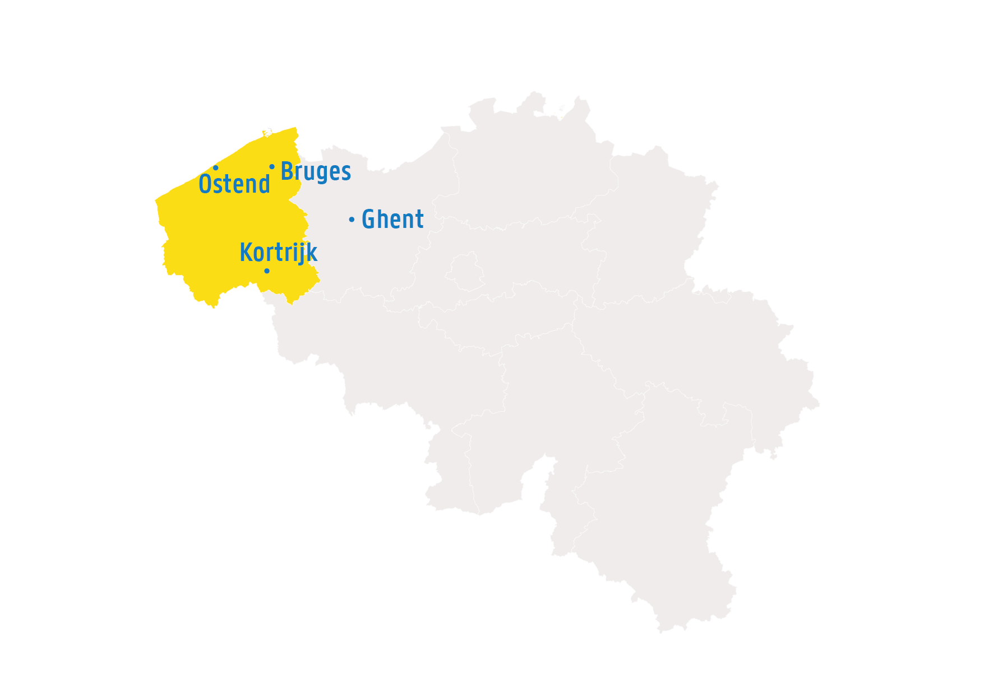
Province
West-flanders

Slide 31
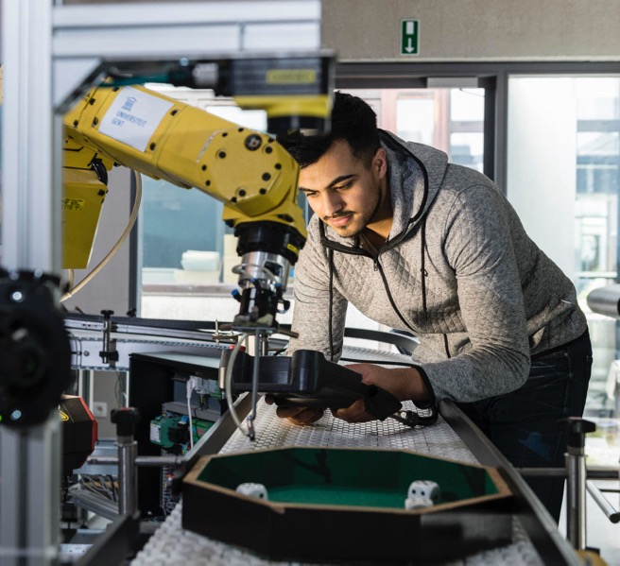
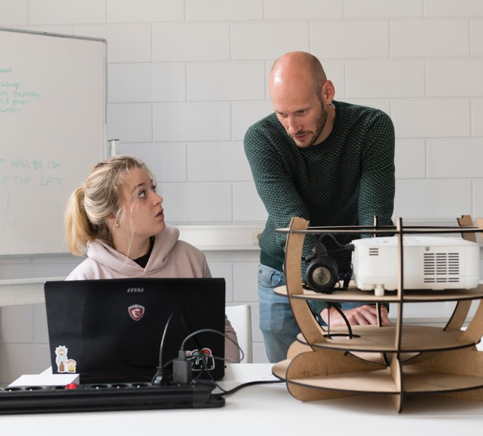
CAMPUS KORTRIJK
2 unique, practice-oriented engineering technology programmes:
Machine and Production Automisation
Industrial Design
Notes:
Founded 1st of October 2013
Since 2018: 2 new study programmes in industrial engineering - unique in Flanders.
Practice-oriented campus with 650 students - 120 staff members (lecturers, researchers, scientific and administrative personnel)
From the Faculty of Engineering and Architecture

Slide 32
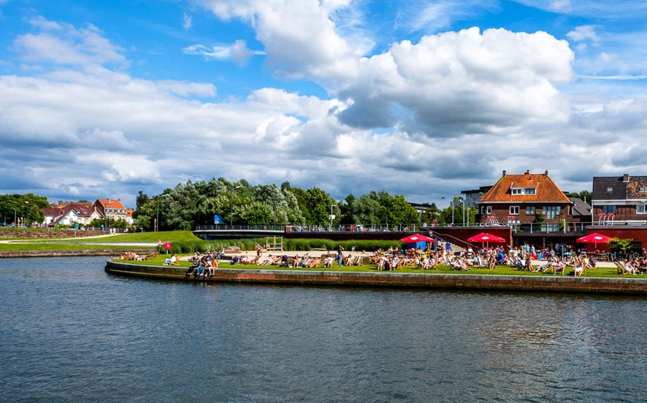
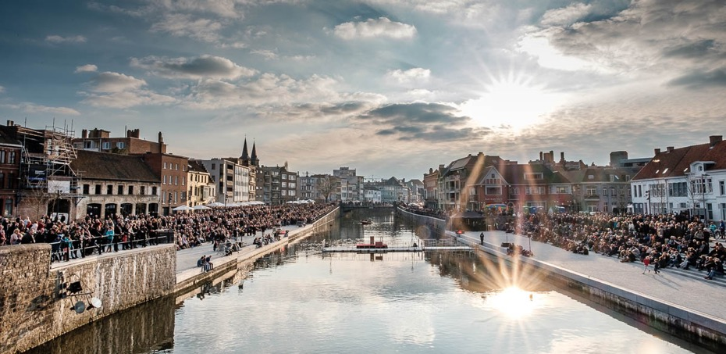

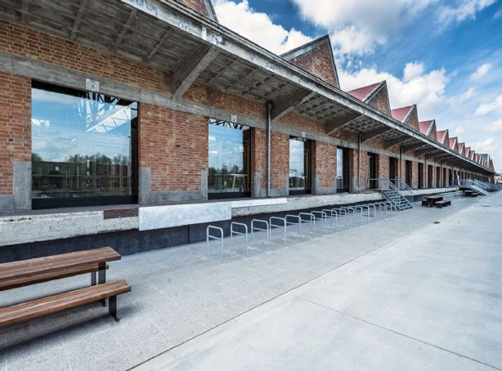
KORTRIJK

Slide 33
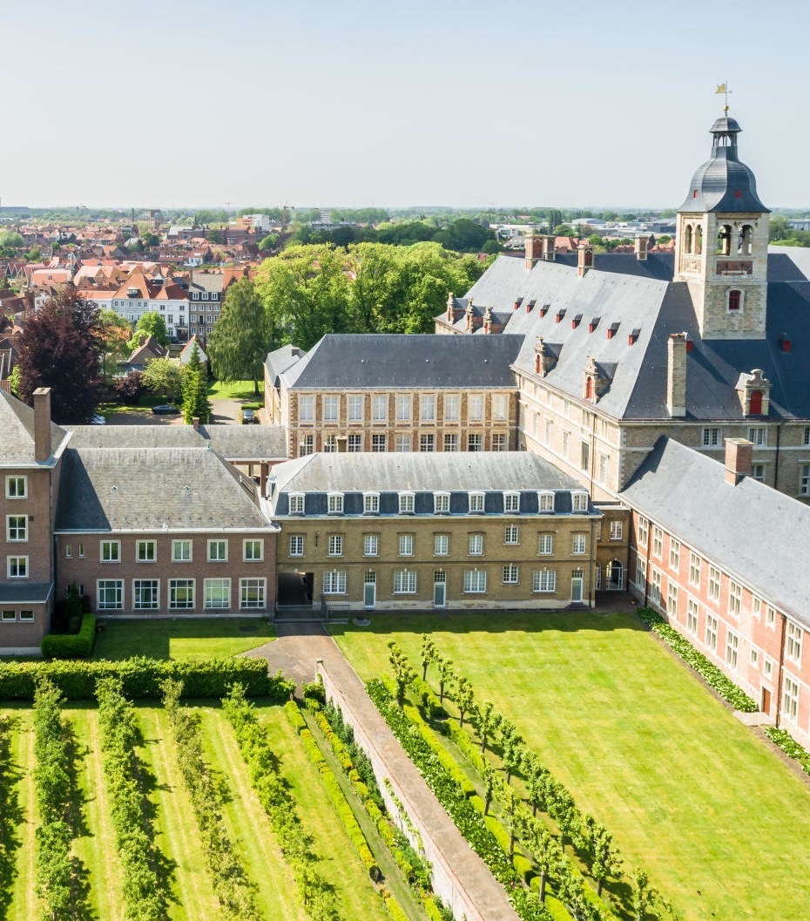

CAMPUS BRUGEs
United Nations University on
Comparative Regional Integration
Studies (UNU-CRIS)
Notes:
Ghent University department of the United Nations, in cooperation with the VUB. Economists, political scientists and lawyers do research into regional integration processes and the role of regionalisation in a globalized world. UNU-CRIS also functions as a think tank for several governments.

Slide 34

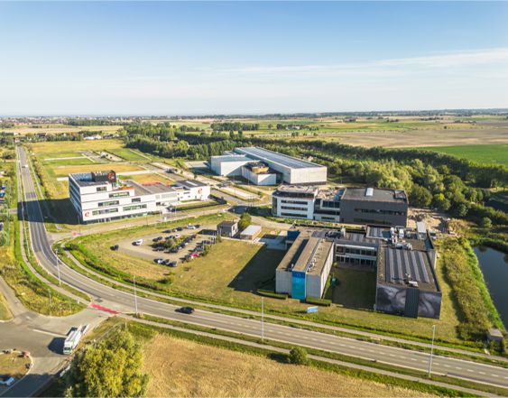
Ostend science park
Boosting Blue Economy
Collaboration between Ghent University, government
and industry in the marine and maritime sector
for a blue economy.
ostendsciencepark.be
Boosting Blue Economy
Research and industry
boosting the Blue Economy
ostendsciencepark.be

Slide 35

South korea

Slide 36
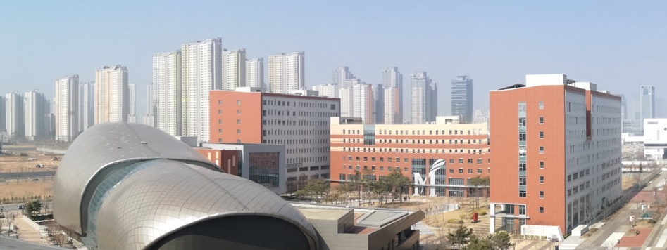
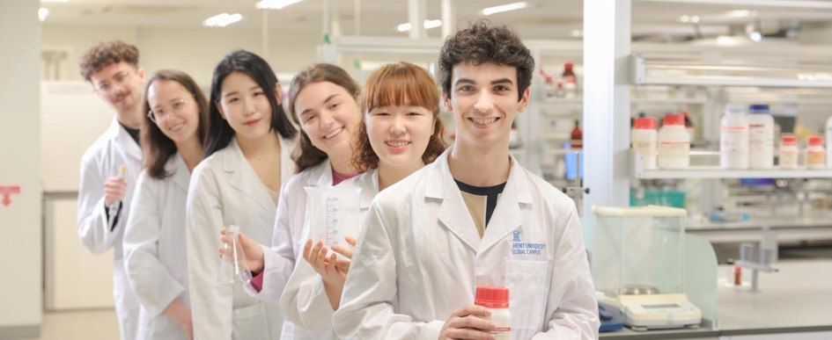
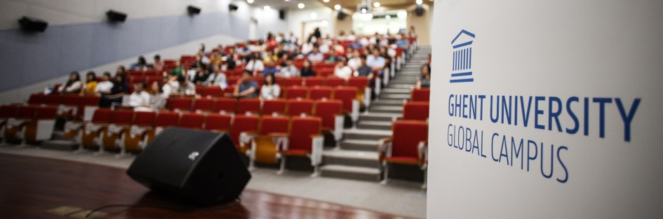
GHENT UNIVERSITY
GLOBAL CAMPUS
The first European university in Songdo, South Korea
Ghent University Asian hub since 2014:
+500 students in bio, food and environmental technology.
Notes:
Ghent University Global Campus is the first European university in Songdo, South-Korea. GUGC opened its doors in 2014 as an important Asian hub for bio industry and life sciences, in collaboration with the South-Korean government. www.ugent.be/globalcampus

Slide 37
MANAGEMENT

Slide 38
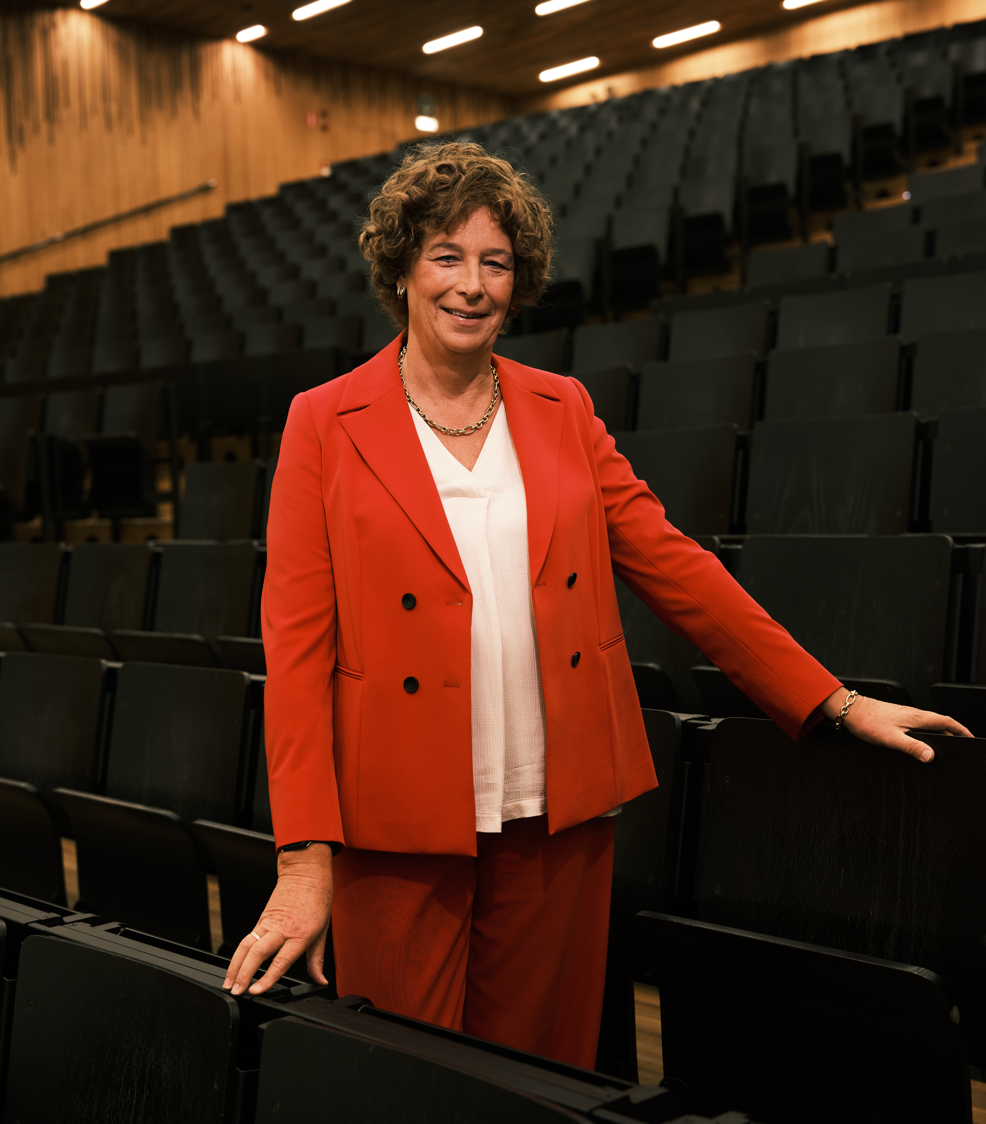
Rector
Professor Petra De Sutter
Notes:
Professor Petra De Sutter is the 84rd rector of Ghent University. She was appointed at the beginning of the 2025-2026 academic year.

Slide 39
ORGANIsation
Board of Governors
Executive Board
Rector and Vice-Rector
Chief academic administrator
3 university services
led by directors
in different service clusters and teams
Management Committee
Chief logistics administrator
11 faculties
led by deans and Faculty Councils
in different Departments and Research Groups

Slide 40
organisation
University service
Education and Research
University service
People and Organisation
University service
Real Estate and Campus Facilities,
ICT and Student Facilities
Education
Human Resources
Real Estate and Campus Facilities
Research
Finance
ICT
Communication and Marketing
Governance, Legal Affairs and Compliance
Student Facilities
Internationalisation

Slide 41























11 faculties
41
41
Notes:
We are a comprehensive university, with 11 faculties, spread across several buildings and campuses in and around the city of Ghent.
Each faculty is managed by the dean and the faculty board, consisting of a number of departments (adding up to about 80 departments).

Slide 42

PERSONnel
Ghent University: 9,700 employees
(21% international)
Ghent University Hospital: 6,000 employees
DIVERSITy
OPEN corporate culture
Competence-based
participation
EVALUATIon & guidance

Slide 43
INTERNATIONAL

Slide 44


Enlight
EUROPEAN UNIVERSITIES NETWORK
Prestigious initiative European Commission
Duration 2021-2027
9 full members + 1 associated member
Motor for educational innovation at
Ghent University

Slide 45


foreign STUDENTs
Total students | 50,936
International students | 7,577* (15%)
Top 3 faculties with international students
Faculty of Science | 1,057
Faculty of Engineering and Architecture | 1,041
Faculty of Bioscience Engineering | 1,033
(reference period: 15 October 2025)
* Global Campus in South-Korea included

Slide 46

Current focus of INTERNATIONALIsation
Strategic objective for education
25% of all graduates has experience abroad
100% of study programmes have international and intercultural competencies embedded in the educational competencies

Slide 47

STUDENT MOBILITy
1,691
Foreign exchange students
at Ghent University
2,320
Ghent University
students abroad
(For the past academic year 2024-2025)

Slide 48


Development cooperation
Projects with university partners in developing countries
Education
Research
Capacity Building
Notes:
Education:
7 International Course Programmes: English-taught programmes organized within the framework of development cooperation

Slide 49

regional PLATFORms
Notes:
These platforms enhance the collaboration between Ghent University and international regions:
www.ugent.be/regionalplatforms

Slide 50

ERASMUS+ educational projects
Erasmus+ projects as motor for internationalisation, innovation in education and creation of societal value
2024: 61 active E+-projects in all Actions (KA2/KA3)
Projects with a direct connection to EU policy (e.g. Erasmus Without Paper)
17 active Erasmus Mundus Masters;
European leader as coordinating institution

Slide 51






International networking organisations
Notes:
- The European University Association has more than 800 members from 48 different countries. Via EUA working groups composed of representatives of the National Rectors Conference (NRC), VLIR in our case, Ghent University participates actively in the drafting of EUA position papers, policy papers and in EUA European policy events. More broadly, EUA's publications address topics that are of relevance for European research, education and innovation policy, institutional university policy and management.
As the European association of leading specialised and comprehensive universities of science and technology, CESAER champions excellence in higher education, training, research and innovation; influences debate; contributes to the realisation of open knowledge societies; and delivers significant scientific, economic, social and societal impact. Three of the five core missions are to learn from each other, to influence policy-makers and funders to share European strategies, policies and funding programmes and to boost participation in European funding programmes.
The Guild of European research intensive universities was created in 2016 and is composed of 21 members in 16 countries across Europe. The Guild is committed to the pursuit of excellence, the importance of truth-seeking and trust-building as the foundation of public life, and the creation of new knowledge for the benefit of society, culture, and economic growth.
The European University Foundation bonds 20 public universities in Europe that share a culture of academic excellence. EUF is in the forefront of European HE policy making since more than a decade, promoting high quality student mobility and a strong European Higher Education area, with a particular emphasis on the development of the Erasmus+ programme through participation in key projects.
The SGroup network is composed of over 43 higher education institutions from 20 European countries and 5 countries outside Europe. With over 30 years of experience in university collaboration it focuses on four core areas of co-operation: internationalisation strategy, academic collaboration, academic mobility, and transfer of knowledge.
UnILiON is an informal network of 50 liaison offices representing 156 excellent universities based in Europe, Japan and Russia. It offers a platform for exchange where the participants share information, nurture collaboration and act as information multipliers towards the represented organisations. The focus for the exchanges lies on the European Research Area policy developments and on Horizon Europe policies.

Slide 52







Universiteit Gent
@ugent
@ugent
Ghent University
youtube.com/ugent
A KNOWLEDGE LOVE STORY
Image film
about Ghent University
DARE TO THINK
Our DNA:
critical thinking
www.ugent.be
Copyright images © Universiteit Gent
By photographers: Hilde Christiaens, Jonas Vandecasteele en Yentl Vandendriessche, Christophe Vander Eecken,
Nic Vermeulen, Layla Aerts, Anneke D’Hollander, Kattoo, Martin Corlazzoli, Stad Gent - Dienst Toerisme & Bas Bogaerts

